Slide 1

LET US C
BY YASHAVANT KANETKAR
CH 4 Q[E]
CH 4 Q[C]
CH 4 Q[A]
CH 4 Q[D]
CH 4 Q[B]
CHAPTER 4 SOLUTIONS
MORE COMPLEX DECISION MAKING

Slide 2
CHAPTER 4 SOLUTIONS
MORE COMPLEX DECISION MAKING
Q[A] if a = 10, b = 12, c = 0, find the values of the expressions in the following table:
CH 4 Q[A]
Expression | Value
a != 6 && b > 5 | 1
a == 9 || b < 3
! ( a < 10 )
! ( a > 5 && c )
5 && c != 8 || !c
CH 4 Q[E]
CH 4 Q[C]
CH 4 Q[D]
CH 4 Q[B]
DEAR CODING
BOOK: LET US C
BY YASHAVANT KANETKAR

Slide 3
CHAPTER 4 SOLUTIONS
MORE COMPLEX DECISION MAKING
Q[A] if a = 10, b = 12, c = 0, find the values of the expressions in the following table:
CH 4 Q[A]
Expression | Solution Steps | Value
a != 6 && b > 5
a == 9 || b < 3
! ( a < 10 )
! ( a > 5 && c )
5 && c != 8 || !c
DEAR CODING
BOOK: LET US C
BY YASHAVANT KANETKAR

Slide 4
CHAPTER 4 SOLUTIONS
MORE COMPLEX DECISION MAKING
Q[A] if a = 10, b = 12, c = 0, find the values of the expressions in the following table:
CH 4 Q[A]
Expression | Solution Steps | Value
a != 6 && b > 5 | = 1 && 1
a == 9 || b < 3
! ( a < 10 )
! ( a > 5 && c )
5 && c != 8 || !c
DEAR CODING
BOOK: LET US C
BY YASHAVANT KANETKAR

Slide 5
CHAPTER 4 SOLUTIONS
MORE COMPLEX DECISION MAKING
Q[A] if a = 10, b = 12, c = 0, find the values of the expressions in the following table:
CH 4 Q[A]
Expression | Solution Steps | Value
a != 6 && b > 5 | = 1 && 1 | 1
a == 9 || b < 3
! ( a < 10 )
! ( a > 5 && c )
5 && c != 8 || !c
DEAR CODING
BOOK: LET US C
BY YASHAVANT KANETKAR

Slide 6
CHAPTER 4 SOLUTIONS
MORE COMPLEX DECISION MAKING
Q[A] if a = 10, b = 12, c = 0, find the values of the expressions in the following table:
CH 4 Q[A]
Expression | Solution Steps | Value
a != 6 && b > 5 | = 1 && 1 | 1
a == 9 || b < 3 | = 0 || 0
! ( a < 10 )
! ( a > 5 && c )
5 && c != 8 || !c
DEAR CODING
BOOK: LET US C
BY YASHAVANT KANETKAR

Slide 7
CHAPTER 4 SOLUTIONS
MORE COMPLEX DECISION MAKING
Q[A] if a = 10, b = 12, c = 0, find the values of the expressions in the following table:
CH 4 Q[A]
Expression | Solution Steps | Value
a != 6 && b > 5 | = 1 && 1 | 1
a == 9 || b < 3 | = 0 || 0 | 0
! ( a < 10 )
! ( a > 5 && c )
5 && c != 8 || !c
DEAR CODING
BOOK: LET US C
BY YASHAVANT KANETKAR

Slide 8
CHAPTER 4 SOLUTIONS
MORE COMPLEX DECISION MAKING
Q[A] if a = 10, b = 12, c = 0, find the values of the expressions in the following table:
CH 4 Q[A]
Expression | Solution Steps | Value
a != 6 && b > 5 | = 1 && 1 | 1
a == 9 || b < 3 | = 0 || 0 | 0
! ( a < 10 ) | = ! ( 0 )
! ( a > 5 && c )
5 && c != 8 || !c
DEAR CODING
BOOK: LET US C
BY YASHAVANT KANETKAR

Slide 9
CHAPTER 4 SOLUTIONS
MORE COMPLEX DECISION MAKING
Q[A] if a = 10, b = 12, c = 0, find the values of the expressions in the following table:
CH 4 Q[A]
Expression | Solution Steps | Value
a != 6 && b > 5 | = 1 && 1 | 1
a == 9 || b < 3 | = 0 || 0 | 0
! ( a < 10 ) | = ! ( 0 ) | 1
! ( a > 5 && c )
5 && c != 8 || !c
DEAR CODING
BOOK: LET US C
BY YASHAVANT KANETKAR

Slide 10
CHAPTER 4 SOLUTIONS
MORE COMPLEX DECISION MAKING
Q[A] if a = 10, b = 12, c = 0, find the values of the expressions in the following table:
CH 4 Q[A]
Expression | Solution Steps | Value
a != 6 && b > 5 | = 1 && 1 | 1
a == 9 || b < 3 | = 0 || 0 | 0
! ( a < 10 ) | = ! ( 0 ) | 1
! ( a > 5 && c ) | = ! ( 1 && 0 )
5 && c != 8 || !c
DEAR CODING
BOOK: LET US C
BY YASHAVANT KANETKAR

Slide 11
CHAPTER 4 SOLUTIONS
MORE COMPLEX DECISION MAKING
Q[A] if a = 10, b = 12, c = 0, find the values of the expressions in the following table:
CH 4 Q[A]
Expression | Solution Steps | Value
a != 6 && b > 5 | = 1 && 1 | 1
a == 9 || b < 3 | = 0 || 0 | 0
! ( a < 10 ) | = ! ( 0 ) | 1
! ( a > 5 && c ) | = ! ( 1 && 0 ) = ! ( 0 )
5 && c != 8 || !c
DEAR CODING
BOOK: LET US C
BY YASHAVANT KANETKAR

Slide 12
CHAPTER 4 SOLUTIONS
MORE COMPLEX DECISION MAKING
Q[A] if a = 10, b = 12, c = 0, find the values of the expressions in the following table:
CH 4 Q[A]
Expression | Solution Steps | Value
a != 6 && b > 5 | = 1 && 1 | 1
a == 9 || b < 3 | = 0 || 0 | 0
! ( a < 10 ) | = ! ( 0 ) | 1
! ( a > 5 && c ) | = ! ( 1 && 0 ) = ! ( 0 ) | 1
5 && c != 8 || !c
DEAR CODING
BOOK: LET US C
BY YASHAVANT KANETKAR

Slide 13
CHAPTER 4 SOLUTIONS
MORE COMPLEX DECISION MAKING
Q[A] if a = 10, b = 12, c = 0, find the values of the expressions in the following table:
CH 4 Q[A]
Expression | Solution Steps | Value
a != 6 && b > 5 | = 1 && 1 | 1
a == 9 || b < 3 | = 0 || 0 | 0
! ( a < 10 ) | = ! ( 0 ) | 1
! ( a > 5 && c ) | = ! ( 1 && 0 ) = ! ( 0 ) | 1
5 && c != 8 || !c | = 5 && 1 || 1
DEAR CODING
BOOK: LET US C
BY YASHAVANT KANETKAR

Slide 14
CHAPTER 4 SOLUTIONS
MORE COMPLEX DECISION MAKING
Q[A] if a = 10, b = 12, c = 0, find the values of the expressions in the following table:
CH 4 Q[A]
Expression | Solution Steps | Value
a != 6 && b > 5 | = 1 && 1 | 1
a == 9 || b < 3 | = 0 || 0 | 0
! ( a < 10 ) | = ! ( 0 ) | 1
! ( a > 5 && c ) | = ! ( 1 && 0 ) = ! ( 0 ) | 1
5 && c != 8 || !c | = 5 && 1 || 1 = 1 || 1
DEAR CODING
BOOK: LET US C
BY YASHAVANT KANETKAR

Slide 15
CHAPTER 4 SOLUTIONS
MORE COMPLEX DECISION MAKING
Q[A] if a = 10, b = 12, c = 0, find the values of the expressions in the following table:
CH 4 Q[A]
Expression | Solution Steps | Value
a != 6 && b > 5 | = 1 && 1 | 1
a == 9 || b < 3 | = 0 || 0 | 0
! ( a < 10 ) | = ! ( 0 ) | 1
! ( a > 5 && c ) | = ! ( 1 && 0 ) = ! ( 0 ) | 1
5 && c != 8 || !c | = 5 && 1 || 1 = 1 || 1 | 1
DEAR CODING
BOOK: LET US C
BY YASHAVANT KANETKAR

Slide 16
CHAPTER 4 SOLUTIONS
MORE COMPLEX DECISION MAKING
Q[B] What will be the output of the following programs:
CH 4 Q[B]
#include <stdio.h>
int main()
{
int i = 4, j = -1,
k = 0, w, x, y, z;
w = i || j || k;
x = i && j && k;
y = i || j && k;
z = i && j || k;
printf("w = %d x = %d y = %d z = %d\n", w, x, y, z);
return 0;
}
(b)
#include <stdio.h>
int main()
{
int i = 4, z = 12;
if ( i = 5 || z > 50 )
printf("Dean of students affairs\n");
else
printf("Dosa\n");
return 0;
}
(a)
(c)
(d)
(e)
DEAR CODING
(f)
BOOK: LET US C
BY YASHAVANT KANETKAR

Slide 17
CHAPTER 4 SOLUTIONS
MORE COMPLEX DECISION MAKING
(a)
#include <stdio.h>
int main()
{
int i = 4, z = 12;
if ( i = 5 || z > 50 )
printf("Dean of students affairs\n");
else
printf("Dosa\n");
return 0;
}
CH 4 Q[B](a)
DEAR CODING
👩‍💻 Output:
BOOK: LET US C
BY YASHAVANT KANETKAR

Slide 18
CHAPTER 4 SOLUTIONS
MORE COMPLEX DECISION MAKING
(b)
#include <stdio.h>
int main()
{
int i = 4, j = -1, k = 0, w, x, y, z;
w = i || j || k;
x = i && j && k;
y = i || j && k;
z = i && j || k;
printf("w = %d x = %d y = %d z = %d\n", w, x, y, z);
return 0;
}
CH 4 Q[B](b)
DEAR CODING
👩‍💻 Output:
BOOK: LET US C
BY YASHAVANT KANETKAR

Slide 19

CHAPTER 4 SOLUTIONS
MORE COMPLEX DECISION MAKING
(c)
#include <stdio.h>
int main()
{
int x = 20, y = 40, z = 45;
if ( x > y && x > z )
printf("biggest = %d\n", x);
else if (y > x && y > z)
printf("biggest = %d\n", y);
else if (z > x && z > y)
printf("biggest = %d\n", z);
return 0;
}
👩‍💻 Output:
CH 4 Q[B](c)
DEAR CODING
BOOK: LET US C
BY YASHAVANT KANETKAR

Slide 20

CHAPTER 4 SOLUTIONS
MORE COMPLEX DECISION MAKING
(d)
#include <stdio.h>
int main()
{
int i = -1, j = 1, k, l;
k = !i && j;
l = !i || j;
printf("%d %d\n", i, j );
return 0;
}
CH 4 Q[B](d)
👩‍💻 Output:
DEAR CODING
BOOK: LET US C
BY YASHAVANT KANETKAR

Slide 21

CHAPTER 4 SOLUTIONS
MORE COMPLEX DECISION MAKING
(e)
#include <stdio.h>
int main()
{
int i = -4, j, num;
j = ( num < 0 ? 0 : num * num );
printf("%d\n", j);
return 0;
}
CH 4 Q[B](e)
👩‍💻
Output:
DEAR CODING
✍️ num is not initialized. So, it will contain some garbage value. Hence the output is unpredictable.
BOOK: LET US C
BY YASHAVANT KANETKAR

Slide 22

CHAPTER 4 SOLUTIONS
MORE COMPLEX DECISION MAKING
(f)
#include <stdio.h>
int main()
{
int k, num = 30;
k = (num > 5 ? (num <= 10 ? 100 : 200) : 500);
printf("%d\n", num);
return 0;
}
CH 4 Q[B](f)
DEAR CODING
👩‍💻 Output:
BOOK: LET US C
BY YASHAVANT KANETKAR

Slide 23
CHAPTER 4 SOLUTIONS
MORE COMPLEX DECISION MAKING
Q[C] Point out the errors, if any, in the following C programs:
CH 4 Q[C]
(a)
(b)
#include <stdio.h>
int main()
{
int code, flag;
if (code == 1 & flag == 0)
printf("The eagle has landed\n");
return 0;
}
#include <stdio.h>
int main()
{
char spy='a', password = 'z';
if (spy == 'a' or password == 'z')
printf("All the birds are safe in the nest\n");
return 0;
}
DEAR CODING
(c)
(d)
(e)
(f)
(g)
(h)
(i)
(j)
BOOK: LET US C
BY YASHAVANT KANETKAR

Slide 24
CHAPTER 4 SOLUTIONS
MORE COMPLEX DECISION MAKING
(a)
✍️ It's a good practice to initialize variables with a value before using them, especially when comparing them in conditional statements.
#include <stdio.h>
int main()
{
int code, flag;
if (code == 1 & flag == 0)
printf("The eagle has landed\n");
return 0;
}
CH 4 Q[C](a)
✅ No error!
✍️ The variables code and flag are not initialized. They contain garbage values. The if statement check code == 1 & flag == 0 will always evaluate false. Therefore, the program will not execute the printf statement inside the if block and will not produce any output.
DEAR CODING
BOOK: LET US C
BY YASHAVANT KANETKAR

Slide 25
CHAPTER 4 SOLUTIONS
MORE COMPLEX DECISION MAKING
(b)
❌ ERROR!
#include <stdio.h>
int main()
{
char spy='a', password = 'z';
if ( spy == 'a' or password == 'z' )
printf("All the birds are safe in the nest\n");
return 0;
}
CH 4 Q[C](b)
✍️ The program contains an error. In C, the ‘or’ operator is represented by two vertical bars (‘||’), not the word ‘or’.
DEAR CODING
BOOK: LET US C
BY YASHAVANT KANETKAR

Slide 26

CHAPTER 4 SOLUTIONS
MORE COMPLEX DECISION MAKING
(b)
#include <stdio.h>
int main()
{
char spy='a', password = 'z';
if ( spy == 'a' || password == 'z' )
printf("All the birds are safe in the nest\n");
return 0;
}
CH 4 Q[C](b)
👩‍💻 Output:
DEAR CODING
BOOK: LET US C
BY YASHAVANT KANETKAR

Slide 27

CHAPTER 4 SOLUTIONS
MORE COMPLEX DECISION MAKING
(c)
#include <stdio.h>
int main()
{
int i = 10, j = 20;
if ( i = 5 ) && if ( j = 10 )
printf("Have a nice day\n");
return 0;
}
❌ ERROR!
CH 4 Q[C](c)
✍️ The syntax for using if statement is incorrect. The correct syntax would be
if (condition) {...}
DEAR CODING
BOOK: LET US C
BY YASHAVANT KANETKAR

Slide 28

CHAPTER 4 SOLUTIONS
MORE COMPLEX DECISION MAKING
(c)
#include <stdio.h>
int main()
{
int i = 10, j = 20;
if (i = 5 && (j = 10))
printf("Have a nice day\n");
return 0;
}
CH 4 Q[C](c)
DEAR CODING
👩‍💻 Output:
BOOK: LET US C
BY YASHAVANT KANETKAR

Slide 29
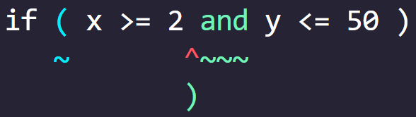
CHAPTER 4 SOLUTIONS
MORE COMPLEX DECISION MAKING
(d)
#include <stdio.h>
int main()
{
int x = 10, y = 20;
if ( x >= 2 and y <= 50 )
printf("%d\n", x);
return 0;
}
❌ ERROR!
CH 4 Q[C](d)
✍️ The error in the above program is the use of "and" instead of "&&" in the if statement.
DEAR CODING
✍️ The "and" operator is not a valid operator in C programming, "&&" is used instead.
BOOK: LET US C
BY YASHAVANT KANETKAR

Slide 30

CHAPTER 4 SOLUTIONS
MORE COMPLEX DECISION MAKING
(d)
#include <stdio.h>
int main()
{
int x = 10, y = 20;
if ( x >= 2 && y <= 50 )
printf("%d\n", x);
return 0;
}
CH 4 Q[C](d)
👩‍💻
Output:
DEAR CODING
BOOK: LET US C
BY YASHAVANT KANETKAR

Slide 31
CHAPTER 4 SOLUTIONS
MORE COMPLEX DECISION MAKING
(e)
#include <stdio.h>
int main()
{
int x = 2;
if ( x == 2 && x != 0 );
printf("Hello\n");
else
printf("Bye\n");
return 0;
}
❌ ERROR!
CH 4 Q[C](e)
✍️ The if statement should not be terminated by a semicolon.
DEAR CODING
BOOK: LET US C
BY YASHAVANT KANETKAR

Slide 32

CHAPTER 4 SOLUTIONS
MORE COMPLEX DECISION MAKING
(e)
#include <stdio.h>
int main()
{
int x = 2;
if ( x == 2 && x != 0 )
printf("Hello\n");
else
printf("Bye\n");
return 0;
}
CH 4 Q[C](e)
👩‍💻 Output:
DEAR CODING
BOOK: LET US C
BY YASHAVANT KANETKAR

Slide 33
CHAPTER 4 SOLUTIONS
MORE COMPLEX DECISION MAKING
(f)
#include <stdio.h>
int main()
{
int i = 10, j = 10;
if ( i && j == 10 )
printf("Have a nice day\n");
return 0;
}
✅ No error!
CH 4 Q[C](f)
DEAR CODING
👩‍💻 Output:
BOOK: LET US C
BY YASHAVANT KANETKAR

Slide 34

CHAPTER 4 SOLUTIONS
MORE COMPLEX DECISION MAKING
(g)
#include <stdio.h>
int main()
{
int j = 65;
printf("j >= 65 ? %d : %c\n", j);
return 0;
}
✅ No error!
CH 4 Q[C](g)
DEAR CODING
👩‍💻 Output:
BOOK: LET US C
BY YASHAVANT KANETKAR

Slide 35

CHAPTER 4 SOLUTIONS
MORE COMPLEX DECISION MAKING
(h)
#include <stdio.h>
int main()
{
int i = 10, j;
i >= 5 ? j = 10 : j = 15;
printf("%d %d\n", i, j);
return 0;
}
❌ ERROR!
CH 4 Q[C](h)
✍️ This will give you an error ‘Lvalue required’.
DEAR CODING
✍️ The error can be overcome by enclosing the statement in the : part within a pair of parentheses. In absence of parentheses, the compiler believes that j is being assigned to the result of the expression to the left of second =. Hence it reports an error.
BOOK: LET US C
BY YASHAVANT KANETKAR

Slide 36

CHAPTER 4 SOLUTIONS
MORE COMPLEX DECISION MAKING
(h)
#include <stdio.h>
int main()
{
int i = 10, j;
i >= 5 ? j = 10 : (j = 15);
printf("%d %d\n", i, j);
return 0;
}
CH 4 Q[C](h)
👩‍💻 Output:
DEAR CODING
BOOK: LET US C
BY YASHAVANT KANETKAR

Slide 37
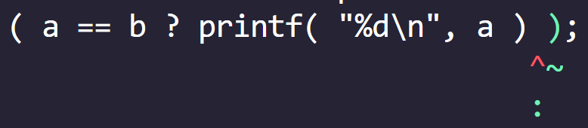
CHAPTER 4 SOLUTIONS
MORE COMPLEX DECISION MAKING
(i)
#include <stdio.h>
int main()
{
int a = 5, b = 6;
( a == b ? printf( "%d\n", a ) );
return 0;
}
❌ ERROR!
CH 4 Q[C](i)
✍️ The ? operator must have a matching : operator.
DEAR CODING
BOOK: LET US C
BY YASHAVANT KANETKAR

Slide 38
CHAPTER 4 SOLUTIONS
MORE COMPLEX DECISION MAKING
(i)
#include <stdio.h>
int main()
{
int a = 5, b = 6;
( a == b ? printf( "%d\n", a ) : 0 );
return 0;
}
CH 4 Q[C](i)
DEAR CODING
BOOK: LET US C
BY YASHAVANT KANETKAR

Slide 39
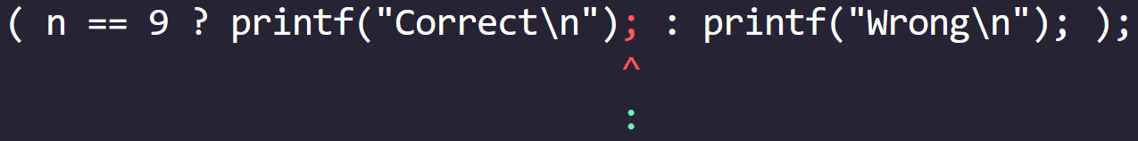
CHAPTER 4 SOLUTIONS
MORE COMPLEX DECISION MAKING
(j)
#include <stdio.h>
int main()
{
int n = 9;
( n == 9 ? printf("Correct\n"); : printf("Wrong\n"); );
return 0;
}
❌ ERROR!
CH 4 Q[C](j)
DEAR CODING
✍️ The program contains a syntax error. The ternary operator " ? : " is used correctly, but the ; after each printf statement should not come.
BOOK: LET US C
BY YASHAVANT KANETKAR

Slide 40

CHAPTER 4 SOLUTIONS
MORE COMPLEX DECISION MAKING
(j)
#include <stdio.h>
int main()
{
int n = 9;
( n == 9 ? printf("Correct\n") : printf("Wrong\n") );
return 0;
}
CH 4 Q[C](j)
DEAR CODING
👩‍💻 Output:
BOOK: LET US C
BY YASHAVANT KANETKAR

Slide 41
CHAPTER 4 SOLUTIONS
MORE COMPLEX DECISION MAKING
Q[D] Attempt the following:
(a) Any year is entered through the keyboard, write a program to determine whether the year is leap or not. Use the logical operators && or ||.
CH 4 Q[D](a)
DEAR CODING
BOOK: LET US C
BY YASHAVANT KANETKAR

Slide 42
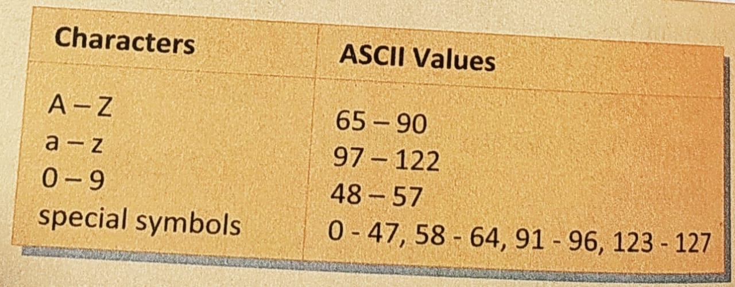
CHAPTER 4 SOLUTIONS
MORE COMPLEX DECISION MAKING
Q[D] Attempt the following:
(b) Any character is entered through the keyboard, write a program to determine whether the character entered is a capital letter, a small case letter, a digit or a special symbol. The following table shows the range of ASCII values for various characters:
CH 4 Q[D](b)
DEAR CODING
BOOK: LET US C
BY YASHAVANT KANETKAR

Slide 43
CHAPTER 4 SOLUTIONS
MORE COMPLEX DECISION MAKING
(c) A certain grade of steel is graded according the following conditions:
Hardness must be greater than 50
Carbon content must be less than 0.7
Tensile strength must be greater than 5600
The grades are as follows:
Grade is 10 if all three conditions are met
Grade is 9 if conditions (i) and (ii) are met
Grade is 8 if conditions (ii) and (iiI) are met
Grade is 7 if conditions (i) and (iii) are met
Grade is 6 if only one condition is met
Grade is 5 if none of the conditions are met
Write a program, which will require the user to give values of hardness, carbon content and tensile strength of the steel under consideration and output the grade of the steel.
CH 4 Q[D](c)
DEAR CODING
BOOK: LET US C
BY YASHAVANT KANETKAR

Slide 44
CHAPTER 4 SOLUTIONS
MORE COMPLEX DECISION MAKING
Q[D] Attempt the following:
(d) if the three sides of a triangle are entered through the keyboard, write a program to check whether the triangle is valid or not. The triangle is valid if the sum of two sides is greater than the largest of the three sides.
CH 4 Q[D](d)
DEAR CODING
BOOK: LET US C
BY YASHAVANT KANETKAR

Slide 45
CHAPTER 4 SOLUTIONS
MORE COMPLEX DECISION MAKING
Q[D] Attempt the following:
(e) If the three sides of a triangle are entered through the keyboard, write a program to check whether the triangle is isosceles, equilateral, scalene or right-angled triangle.
CH 4 Q[D](e)
DEAR CODING
BOOK: LET US C
BY YASHAVANT KANETKAR

Slide 46
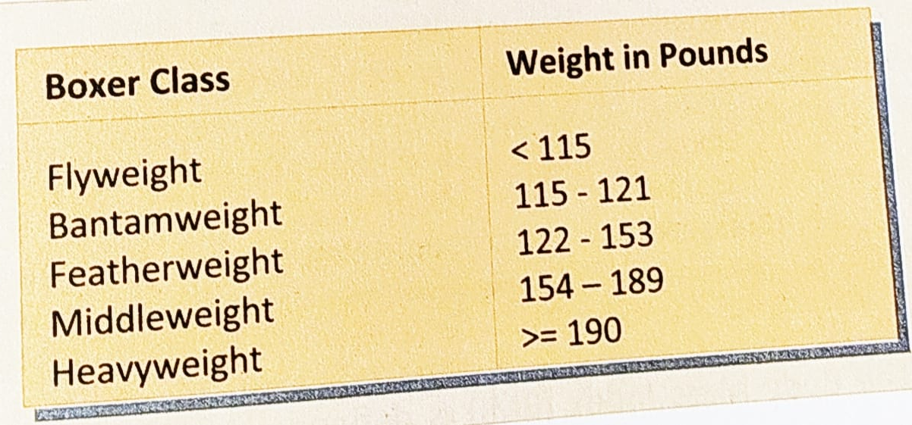
CHAPTER 4 SOLUTIONS
MORE COMPLEX DECISION MAKING
Q[D] Attempt the following:
(f) In boxing the weight class of a boxer is decided as per the following table. Write a program that receives weight as input and prints out the boxer's weight class.
CH 4 Q[D](f)
DEAR CODING
BOOK: LET US C
BY YASHAVANT KANETKAR

Slide 47
CHAPTER 4 SOLUTIONS
MORE COMPLEX DECISION MAKING
Q[D] Attempt the following:
(g) In digital world colors are specified in Red-Green-Blue (RGB) format, with values of R, G, B varying on an integer scale from 0 to 255. In print publishing the colors are mentioned in Cyan-Magenta-Yellow-Black (CMYK) format, with values of C, M, Y, and K varying on a real scale from 0.0 to 1.0. Write a program that converts RGB color to CMYK color as per the following formulae:
CH 4 Q[D](g)
DEAR CODING
BOOK: LET US C
BY YASHAVANT KANETKAR

Slide 48
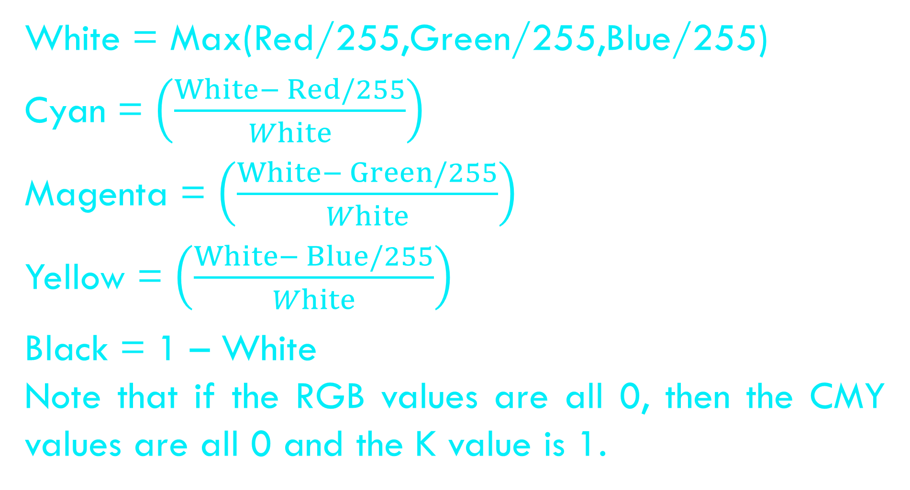
CHAPTER 4 SOLUTIONS
MORE COMPLEX DECISION MAKING
White = Max(Red/255,Green/255,Blue/255)
Cyan = $\left(\frac{White− Red/255}{White}\right)$
Magenta = $\left(\frac{White− Green/255}{White}\right)$
Yellow = $\left(\frac{White− Blue/255}{White}\right)$
Black = 1 – White
Note that if the RGB values are all 0, then the CMY values are all 0 and the K value is 1.
CH 4 Q[D](g)
DEAR CODING
BOOK: LET US C
BY YASHAVANT KANETKAR

Slide 49
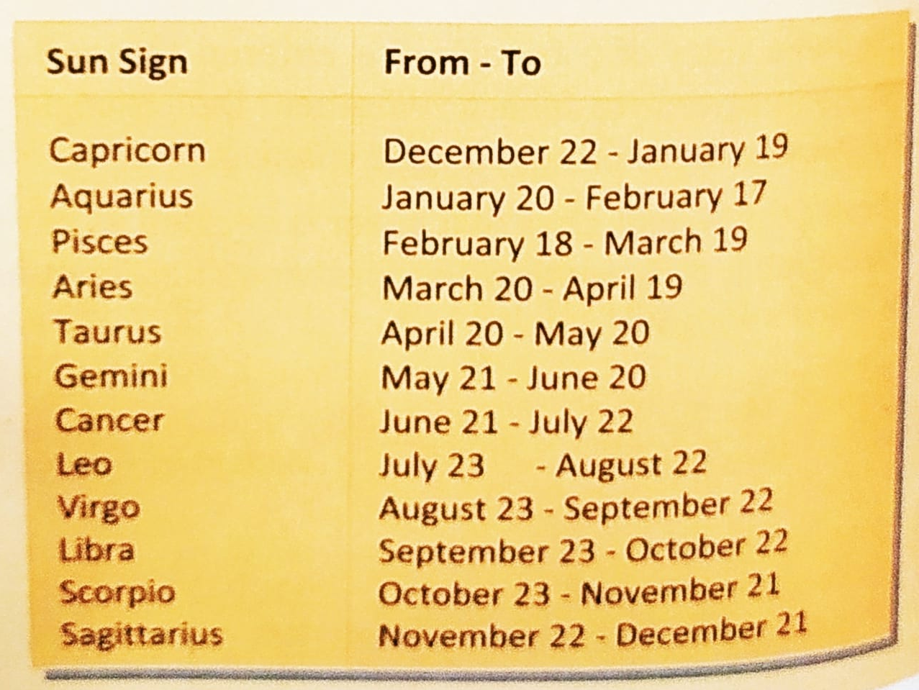
CHAPTER 4 SOLUTIONS
MORE COMPLEX DECISION MAKING
Q[D] Attempt the following:
(h) Write a program that receives month and date of birth as input and prints the corresponding Zodiac sign based on the following table:
CH 4 Q[D](h)
DEAR CODING
BOOK: LET US C
BY YASHAVANT KANETKAR

Slide 50
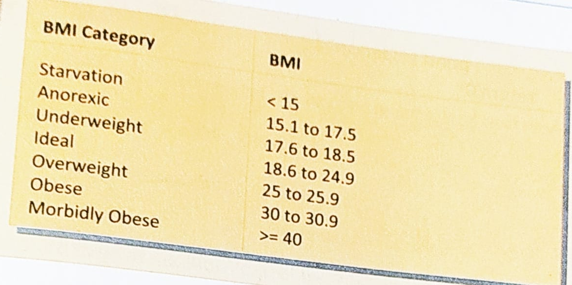
CHAPTER 4 SOLUTIONS
MORE COMPLEX DECISION MAKING
(i) The Body Mass Index (BMI) is defined as ratio of the weight of person (in kilograms) to the square of the height (in meters). Write a program that receives weight and height, calculates the BMI, and reports the BMI category as per the following table:
CH 4 Q[D](i)
DEAR CODING
BOOK: LET US C
BY YASHAVANT KANETKAR

Slide 51
CHAPTER 4 SOLUTIONS
MORE COMPLEX DECISION MAKING
Q[E] Attempt the following:
Using conditional operators determine:
Whether the character entered through the keyboard is lower case alphabet or not.
Whether a character entered through the keyboard is a special symbol or not.
CH 4 Q[E](a)
DEAR CODING
BOOK: LET US C
BY YASHAVANT KANETKAR

Slide 52
CHAPTER 4 SOLUTIONS
MORE COMPLEX DECISION MAKING
Q[E] Attempt the following:
(b) Write a program using conditional operators to determine whether a year entered through the keyboard is a leap year or not.
CH 4 Q[E](b)
DEAR CODING
BOOK: LET US C
BY YASHAVANT KANETKAR

Slide 53
CHAPTER 4 SOLUTIONS
MORE COMPLEX DECISION MAKING
Q[E] Attempt the following:
(c) Write a program to find the greatest of the three numbers entered through the keyboard. Use conditional operators.
CH 4 Q[E](c)
DEAR CODING
BOOK: LET US C
BY YASHAVANT KANETKAR

Slide 54
CHAPTER 4 SOLUTIONS
MORE COMPLEX DECISION MAKING
Q[E] Attempt the following:
(d) Write a program to receive value of an angle in degrees and check whether sum of squares of sine and cosine of this angle is equal to 1.
CH 4 Q[E](d)
DEAR CODING
BOOK: LET US C
BY YASHAVANT KANETKAR

Slide 55
CHAPTER 4 SOLUTIONS
MORE COMPLEX DECISION MAKING
Q[E] Attempt the following:
(e) Rewrite the following program using conditional operators.
#include <stdio.h>
int main()
{
float sal;
printf("Enter the salary");
scanf("%f", &sal);
if (sal >= 25000 && sal <= 40000)
printf("Manager\n");
else
if (sal>= 15000 && sal < 25000)
printf("Accountant\n");
else
printf("Clerk\n");
return 0;
}
CH 4 Q[E](e)
CH 4 Q[E]
CH 4 Q[C]
CH 4 Q[D]
CH 4 Q[B]
DEAR CODING
BOOK: LET US C
BY YASHAVANT KANETKAR

Slide 56
LET US C
BY YASHAVANT KANETKAR
CH 5 Q[B]
CH 5 Q[A]
CHAPTER 5 SOLUTIONS
LOOP CONTROL INSTRUCTION

Slide 57
🔴Let me create amazing coding tutorials for you forever!🙂
👇👇👇👇👇👇👇👇👇👇👇👇👇👇👇👇👇👇
👉SUBSCRIBE🤛
BY YASHAVANT KANETKAR
CH 5 Q[B]
CH 5 Q[A]
CHAPTER 5 SOLUTIONS
LOOP CONTROL INSTRUCTION
Thanks for your valuable time!

Slide 58

CHAPTER 4 SOLUTIONS
MORE COMPLEX DECISION MAKING
(a)
#include <stdio.h>
int main()
{
int code, flag;
if (code == 1 & flag == 0)
printf("The eagle has landed\n");
return 0;
}
a == b
✅ No error!
CH 3 Q[C](a)
👩‍💻 Output:
✍️ This program will not produce any output since the variables code and flag are not initialized. The if statement check code == 1 & flag == 0 will always evaluate to false, because the code and flag are not initialized, they contain garbage values. Therefore the program will not execute the printf statement inside the if block and will not produce any output.
DEAR CODING
BOOK: LET US C
BY YASHAVANT KANETKAR

Slide 59
CHAPTER 3 SOLUTIONS
DECISION CONTROL INSTRUCTION
(d)
#include <stdio.h>
int main()
{
int x = 10;
if (x >= 2) then
printf("%d\n", x);
return 0;
}
CH 3 Q[B](d)
❌
ERROR!
DEAR CODING
✍️ There is no keyword "then“ in C & no variable defined here in program as well.
BOOK: LET US C
BY YASHAVANT KANETKAR

Slide 60
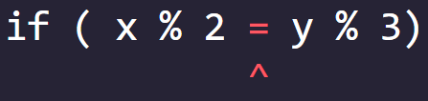
CHAPTER 3 SOLUTIONS
DECISION CONTROL INSTRUCTION
(e)
#include <stdio.h>
int main()
{
int x = 10, y = 15;
if ( x % 2 = y % 3)
printf("Carpathians\n");
return 0;
}
❌ ERROR!
CH 3 Q[B](e)
✍️ C allows only one variable on left hand side of “=“ assignment operator.
DEAR CODING
BOOK: LET US C
BY YASHAVANT KANETKAR

Slide 61

CHAPTER 3 SOLUTIONS
DECISION CONTROL INSTRUCTION
(a)
#include <stdio.h>
int main()
{
int a = 300, b, c;
if (a >= 400)
b = 300;
c = 200;
printf("%d %d\n", b, c);
return 0;
}
👩‍💻 Output:
CH 3 Q[A](a)
✍️ b will contain some garbage value and c will be equal to 200.
DEAR CODING
BOOK: LET US C
BY YASHAVANT KANETKAR

Slide 62
CHAPTER 3 SOLUTIONS
DECISION CONTROL INSTRUCTION
(f)
#include <stdio.h>
int main()
{
int x = 30, y = 40;
if ( x == y)
printf("x is equal to y\n");
else if (x > y)
printf("x is greater than y\n");
else if (x < y)
printf("x is less than y\n");
return 0;
}
CH 3 Q[B](f)
DEAR CODING
BOOK: LET US C
BY YASHAVANT KANETKAR

Slide 63
CHAPTER 3 SOLUTIONS
DECISION CONTROL INSTRUCTION
(g)
#include <stdio.h>
int main()
{
int a, b;
scanf("%d %d", a, b);
if (a > b);
printf("This is a game\n");
else
printf("You have to play it\n");
return 0;
}
CH 3 Q[B](g)
❌ ERROR!
DEAR CODING
✍️ The if statement is terminated due to ; after the ( a > b ). So there is no previous if block for the else block. Hence, there’s an error.
BOOK: LET US C
BY YASHAVANT KANETKAR

